Slide 1
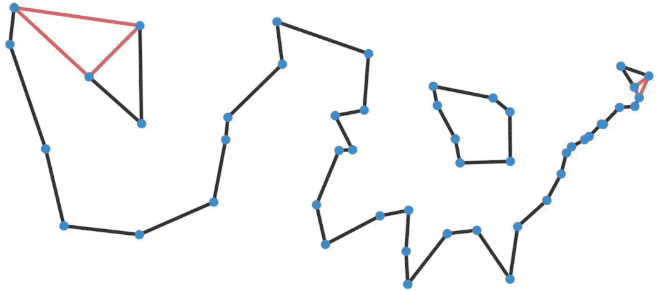
TSP USING GENETIC ALGORITHM
N.MONEESH
AM.EN.U4AIE20150

Slide 2
01
PROJECT SUMMARY

Slide 3
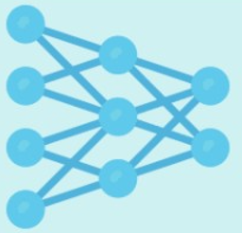
OBJECTIVE
In this project we will be solving travelling salesmen problem using genetic algorithm.
Reason for taking genetic algorithm for tsp:
Genetic Algorithm which is a very good local search algorithm.
It is employed to solve the TSP by generating a number of random tours.
Then improving the population until a stop condition is satisfied.
The best chromosome which is a tour is returned as the solution.
The genetic algorithms are useful for NP-hard problems

Slide 4

02
LITERATURE REVIEW

Slide 5


LITERATURE REVIEW
Naveen Kumar(2012) - A Study of Genetic Algorithm to solve TSP
Varshika Dwivedi(2012) – Travelling Salesman Problem using Genetic
Algorithm.
Chetan Shah(2011) - Comparison of parents selection methods of genetic algorithm for TSP.
Kasassbeh et al(2012) - Shared Crossover Method for Solving Traveling Salesman
Problem.

Slide 6


BACKGROUND STUDY

Slide 7


BACKGROUND STUDY
TSP:
Travel Salesman Problem (TSP) was first formulated in 1930 by Karl Menger.
Since then it became one of the most studied problems in optimization.
The goal of tsp is to find the shortest possible route that visits each city exactly once and return to the origin city,
Which is a least cost problem.
It is an NP-hard problem.
Vehicle routing, computer wiring, wallpaper cutting, and task scheduling are just a few of the unique uses of TSP.
There are many algorithms used to solve the TSP.

Slide 8
BACKGROUND STUDY
Some most frequently used algorithms are Nearest Neighbor algorithm, Genetic algorithm, Greedy Heuristic Algorithm.
In this project we are using genetic algorithm for tsp, so now we will discuss genrtic algorithm in detail.
GENETIC ALGORITHM:
John Holland invented the genetic algorithm in the 1970s, but it became famous in the late 1980s.
Genetic algorithm is a search heuristic that is inspired by Charles Darwin's theory of natural evolution.
This algorithm reflects the process of natural selection where the fittest individuals are selected for reproduction in order to produce offspring of the next generation.

Slide 9
BACKGROUND STUDY
Five phases are considered in a genetic algorithm they are:
Generate population
Calculate fitness function
Choosing appropriate selection operator.
Choosing appropriate crossover operator.
Choosing appropriate mutation operator.
Repeating same process until we get best path(chromosome).

Slide 10

04
METHODS

Slide 11



METHODS
These following steps we will do code for tsp:
Initialize population
Calculate fitness function
Selection : roulette wheel selection operator
Crossover : single point crossover
Mutation : Swap
generateFirstPopulation() :
This function is used for generating the population and in this function.
We have generatePossiblePath() this function is used to give position of each randomly generated cities in path.

Slide 12
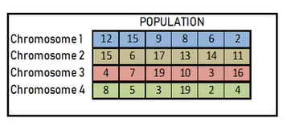
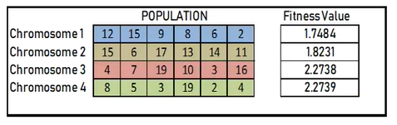
METHODS
We have other function inside generatePossiblePath() that is numberExistsInPath() this checks whether the specified gene is present in the path if its there then it will allot other gene in the path.
fitnessFunction():
So in this function we will calculate the distance between every gene(city) in each chromosome by sqrt()(inbuilt function) for getting the distance.
All these distances will be added then we will get fitness value of that chromosome.

Slide 13
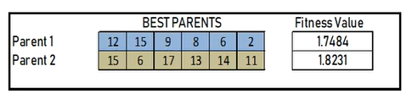
METHODS
rouletteFunction(): This function is used for judging which 2 parents should be mated, the criteria for being best 2 parents is they should have best fitness value comparatively with other parents in the population.
Crossover:
We selected 2 parents by selection operator then we will generate 2 offsprings(childs).
So we should select the particular point where all genes after that point should be crossed.
Here we will use random function to get the point at which we will do crossing.
Then we will make a copy of both parents in to 2 childs by using copy function(inbuilt function) then we will cross the 2 childs at the position where cross is to be done.
Then we will store crossed parts in a temporary variable and then we will swap those crossed parts in original child.

Slide 14

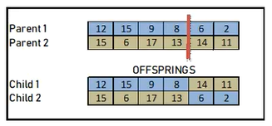
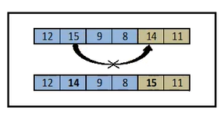
METHODS
There is a function called hasDuplicity() this will check whether the crossed parts are existing previously in the childs or not if the crossed parts are present then we wont swap.
mutate():
In this function we will swap the genes of the particular chromosome internally, here we are taking mutation probability of 5% so we will generate 2 positions where swapping should be done by random function, then we will swap that chromosome at that 2 different genes. So in this way mutation is done.

Slide 15

05
DATA

Slide 16
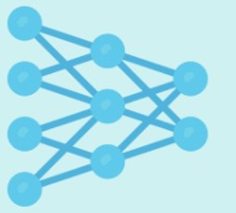
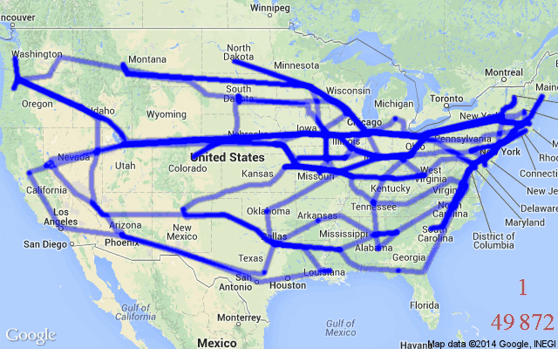
DATA
By using random function(inbuilt function) then we will generate the 10 cities(genes).
Each city will be assigned a integer value between 1 to 10.
So 10 cities means there will be 181440 possible routes to travel.
Our code will find the 1 best route with least cost.

Slide 17


RESULTS

Slide 18



RESULTS
Best route: [3, 7, 10, 9, 2, 1, 4, 8, 5, 6]
Route graph:

Slide 19
RESULTS
Number of iterations vs Cost function graph:

Slide 20
07
DISCUSSION

Slide 21

DISCUSSION
Route graph:
We can see the graph is ending at again (3,3) coordinate(i.e starting city) because the condition of tsp is that the starting city of the tour should be the ending city of the tour so the graph is ending at (3,3) coordinate.
No coordinate point(i.e city) is visited more than 1 time.
It is giving a route with minimum cost compared to other generated routes.
So we can say that our graph is satisfying tsp conditions.
Number of iterations vs Cost function graph:
We can see x axis is number of iterations , y axis is cost function for each iteration the cost function is reducing as the number of iterations are increasing.
At approximately at 100th iteration we can see that the cost function is being constant so we can say that we can stop iterating the code.

Slide 22


08
CONCLUSION

Slide 23


CONCLUSION
Genetic Algorithms employ optimization strategies based on simulation of the natural law of evolution.
Performance of genetic algorithm will be depending on the manner the problem is encoded and which crossover and mutation methods are used.
Genetic algorithm is applicable in various artificial intelligence approaches as well as different fundamental approaches like object-oriented application and robotics etc.
Genetic algorithm produce approximate solutions as we know it wont give exact solution
And also genetic algorithm will take more time for more number of cities.
So the future scope is to reduce the computation time, give exact optimal solution not approximate solution.

Slide 24


REFERENCES

Slide 25
REFERENCES
M. Lalena, “Travelling Salesman Problem Using Genetic Algorithms”, 2003.
Anand, S., Afreen, N., & Yazdani, S. (2015). A Novel and Efficient Selection Method in Genetic Algorithm. Inetrantional Journal of Computer Applications , 129.
Razali, N. M., & Geraghty, J. (2011). Genetic Algorithm Performance with Different Selection Strategies in Solving TSP. Proceedings of the World Congress on Engineering, II. UK.
Naveen kumar, Karambir and Rajiv Kumar, “A Genetic Algorithm Approach To Study Travelling Salesman Problem”, Journal of Global Research in Computer Science, 2012, Vol. 3.
Dwivedi, TarunaChauhan,SanuSaxena and PrincieAgrawal, “Travelling Salesman Problem using Genetic Algorithm”, International Journal of Computer.

Slide 26



